Slide 1

BIG DATA COVID 19 LOCKDOWN ANALYSIS

Slide 2
HARITHA CHILAKALA – HXC210022
SAI PRANEETHA PATHAKAMURI-SXP210117
SINDHURI BONAM- SXB210058
GROUP 3

Slide 3
Objective of the Project
Analyze the impact of lockdown imposed in various countries due to Covid-19
Observe the trend in the countries based on a lockdown hypothesis
Analyze – Does the imposing of lockdown has any effective impact?

Slide 4
Coronavirus disease 2019 (COVID-19) is a contagious disease caused by a virus, the severe acute respiratory syndrome coronavirus . The first known case was identified in Wuhan, China, in December 2019.The disease has spread worldwide, leading to the pandemic.
The COVID-19 pandemic not only halted economic growth, it also constituted a huge challenge to health care capacity.
Risk of coronavirus is increasing daily, even after the government has taken several measures worldwide to minimize covid-19 spread.
Severity of the transmission chain is deemed to be broken only when no new case is reported in an area.
The only way to break the transmission chain is to impose a Lockdown.

Slide 5


Slide 6
Problem Statement
Compare the countries which imposed complete lockdown with the lockdown restrictions and analyze the variation in the number of COVID-19 cases
We are tying to understand if lockdown has any effect in reducing the spread with the help Hadoop, HDFS, Hive?

Slide 7
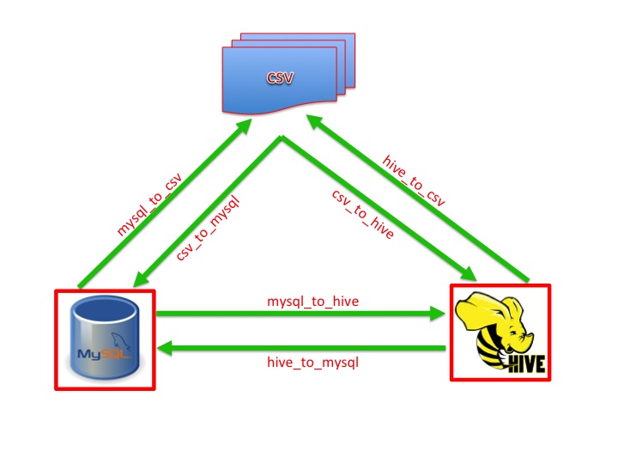

Slide 8
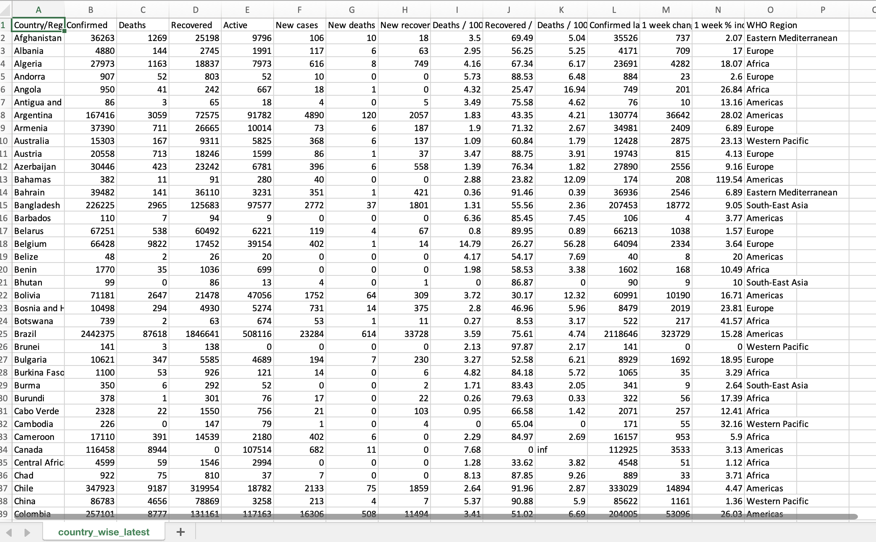
Datasource and Schema Explained
We have pulled the data set from Kaggle
https://www.kaggle.com/datasets/imdevskps/corona-virus-report working on country_wise_latest.csv, full_grouped1.csv It consists of 758MB
country_wise_latest.csv - 15 Columns – Confirmed, Deaths, Recovered,
Active, New cases, New deaths,
new recovered, Deaths/100 cases,
Recovered/100 cases,
Confirmed last week, 1 week change,
1 week % increase, WHO Region
67lakhs unique values
full_grouped1.csv- 10 Columns- Country, Confirmed, Deaths, Recovered, Active, New cases, Newdeaths, Newrecovered, WHORegion

Slide 9
METHODLOGY
1
Data Processing
2
Data Analysis
3
Data Visualization
4
Insights

Slide 10
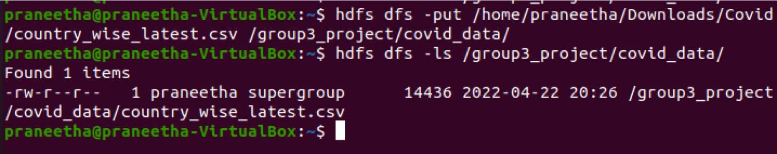
Problem Statement
We have loaded the files into HDFS

Slide 11
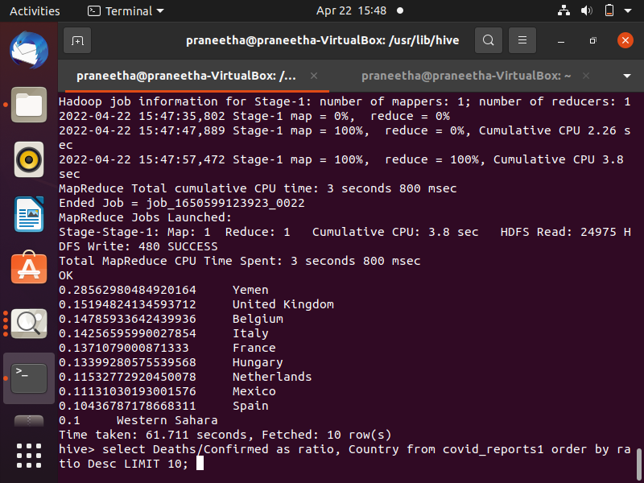
Listing top 10 countries Deaths/Confirmed cases ratio
select Deaths/Confirmed as ratio, Country from covid_reports1 order by ratio Desc LIMIT 10;

Slide 12
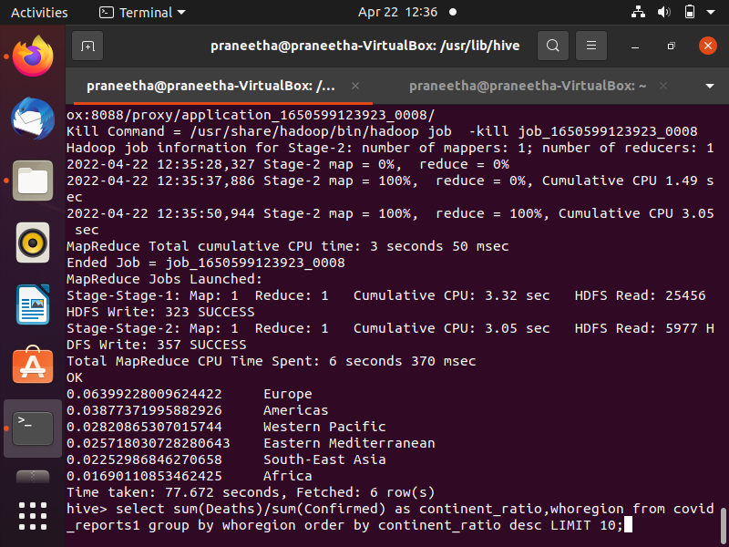
For each continent, we are obtaining the ratio of all the deaths to confirmed cases by adding deaths and confirmed cases of all countries present in that continent.
select sum(Deaths)/sum(Confirmed) as continent_ratio,whoregion from covid_reports1 group by whoregion order by continent_ratio desc LIMIT 10;

Slide 13
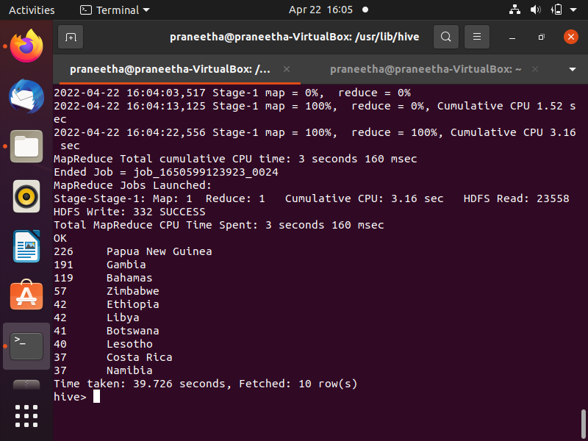
For countries we are obtaining top 10 –one week% increase
select weekincrease,country from covid_reports1 order by weekincrease DESC LIMIT 10;

Slide 14
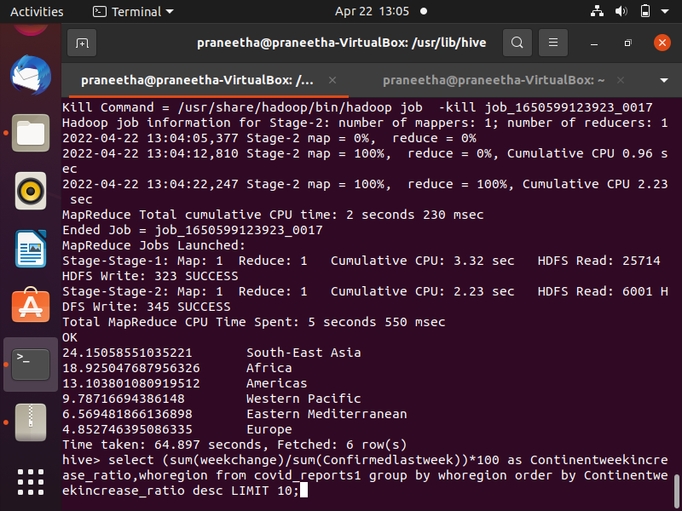
4. For each continent, we are obtaining the week percentage increase by calculating ratio of 1 week change to confirmed last week cases of all the countries in the respective continent
select (sum(weekchange)/sum(Confirmedlastweek))*100 as Continentweekincrease_ratio,whoregion from covid_reports1 group by whoregion order by Continentweekincrease_ratio desc LIMIT 10;

Slide 15
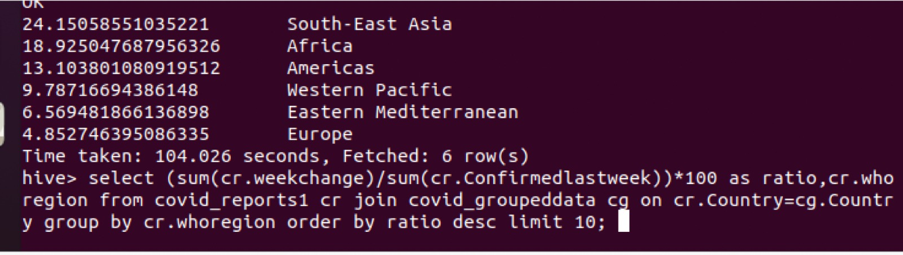

Slide 16
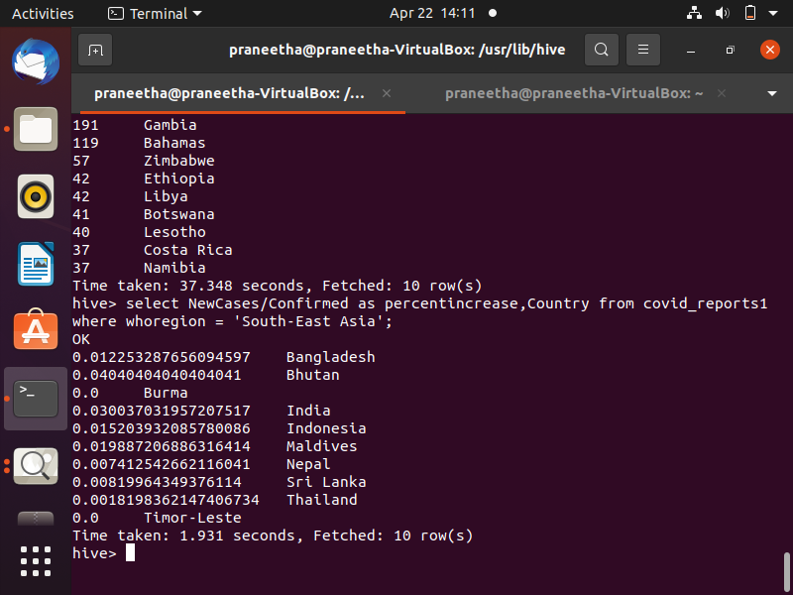
As we have identified the continent that has maximum percent increase in cases
though lockdown is imposed, we are identifying the country that has maximum
increase in cases respective continent
select NewCases/Confirmed as percentincrease,Country from covid_reports1 where whoregion = 'South-East Asia';

Slide 17
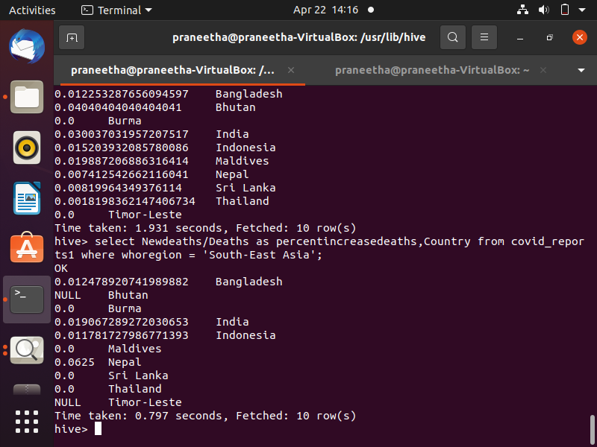
As we have identified the continent that has maximum percent increase in cases though lockdown is imposed,
we are identifying the country that has maximum increase in deaths respective continent
select Newdeaths/Deaths as percentincreasedeaths,Country from covid_reports1 where whoregion = 'South-East Asia';

Slide 18
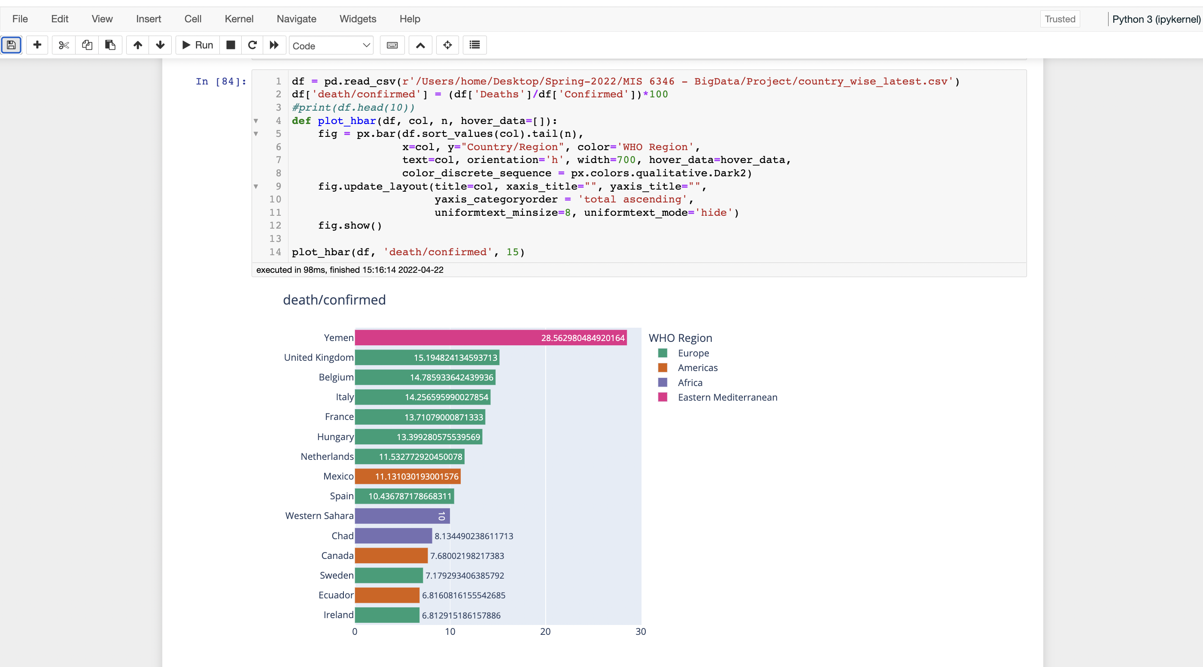
Visualization of top 10 countries Deaths/Confirmed cases ratio

Slide 19
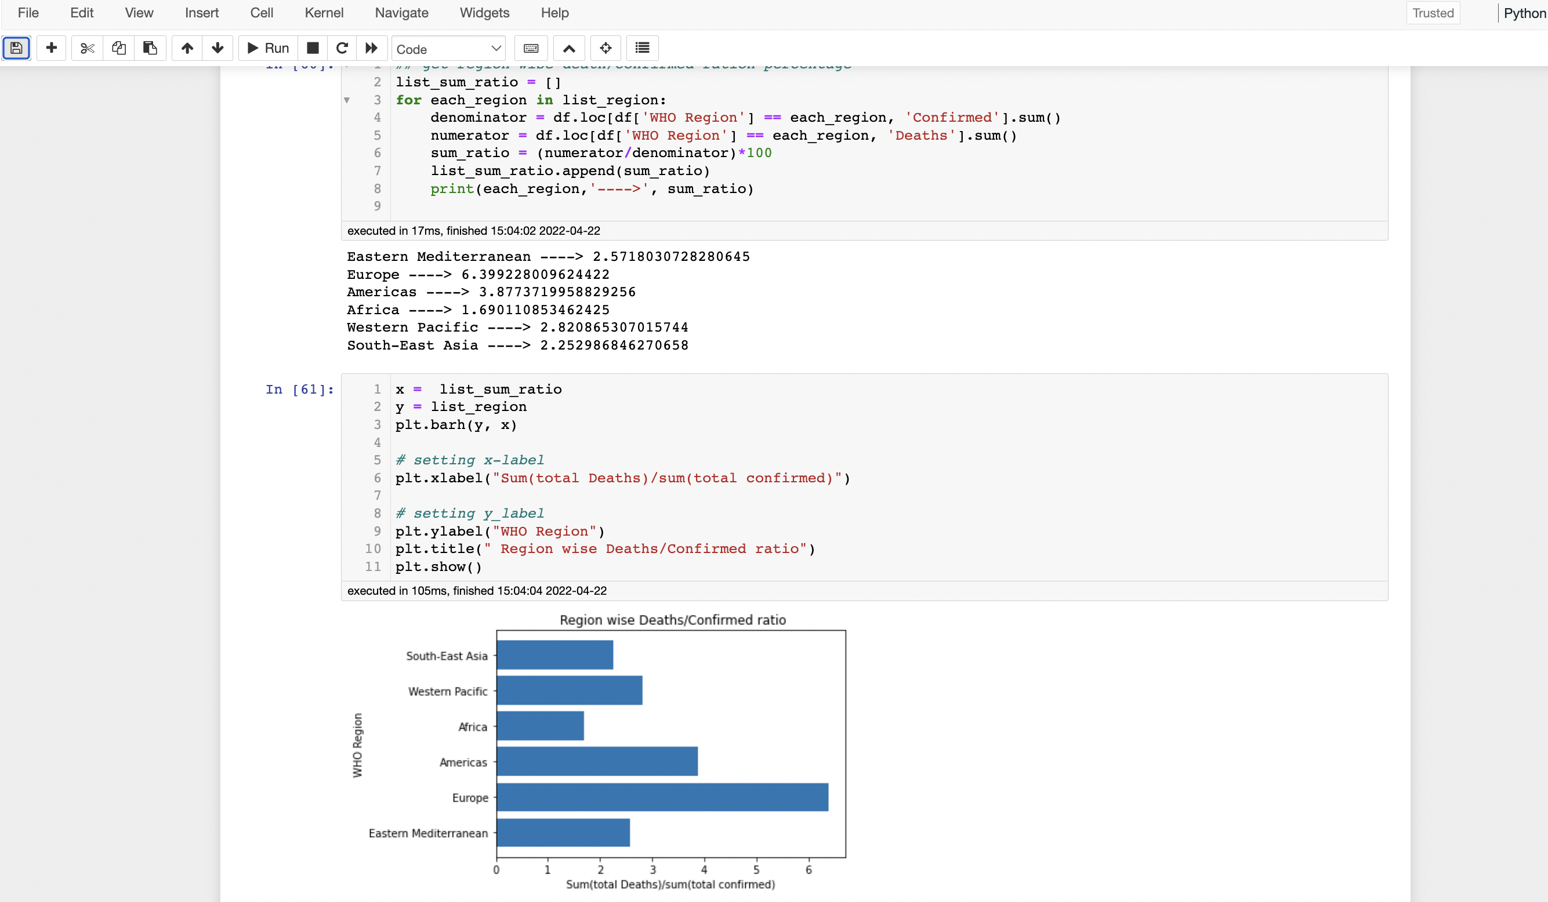
Visualization for each continent, we are obtaining the ratio of all the deaths to confirmed cases
by adding deaths and confirmed cases of all countries present in that continent.

Slide 20
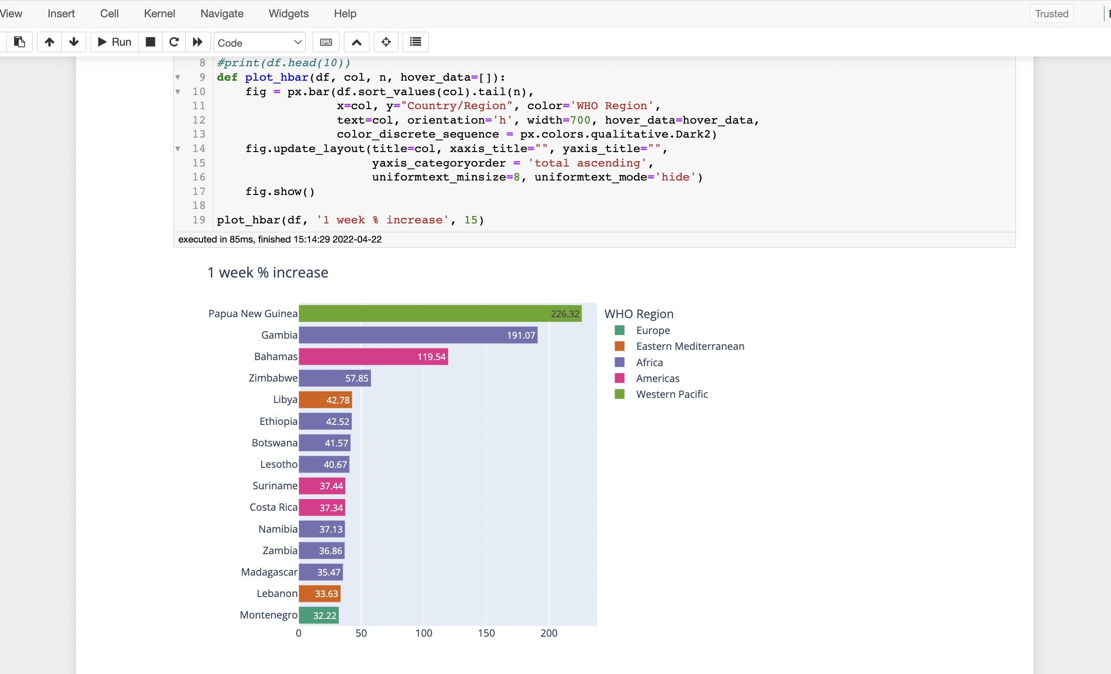
Visualization for countries we are obtaining top 10 –one week% increase

Slide 21
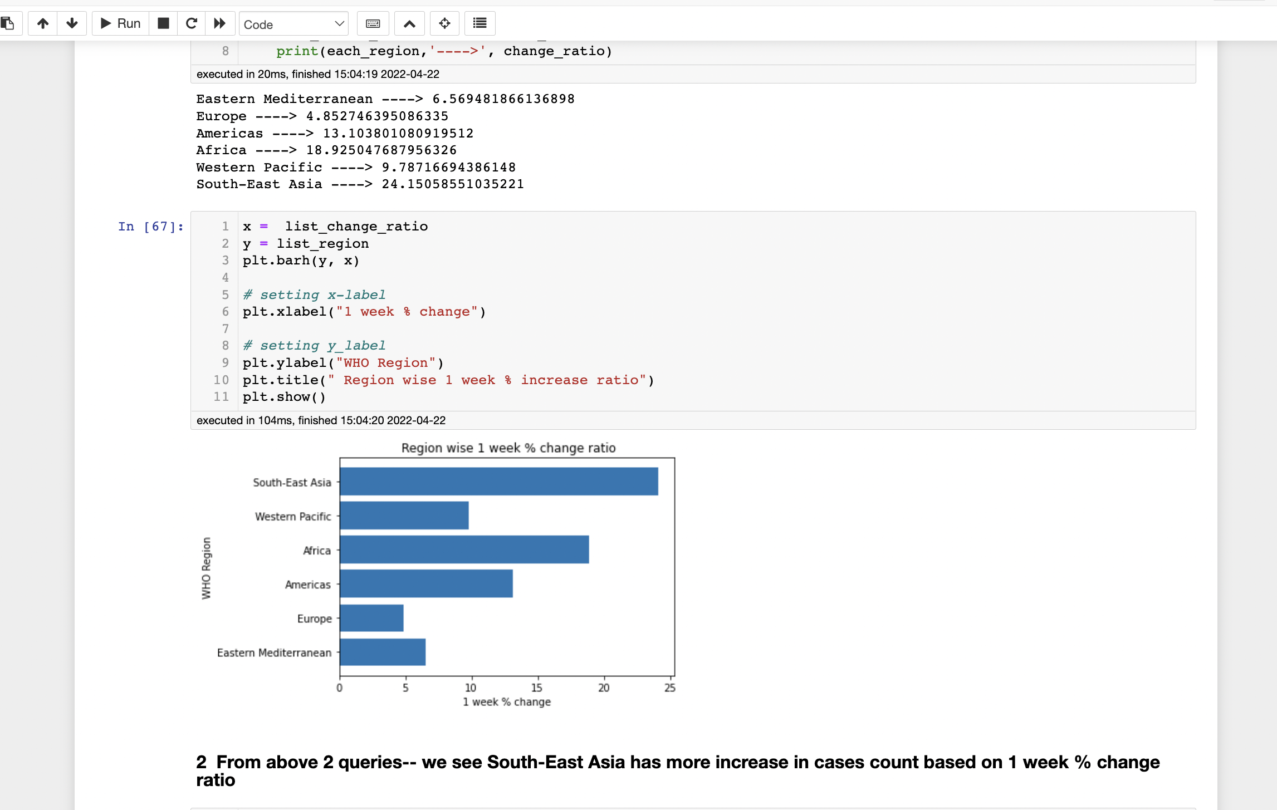
Visualization w.r.t Continents/ WHO Region – showing the value by which
cases count increased in 1 week duration – 1 week % increase

Slide 22
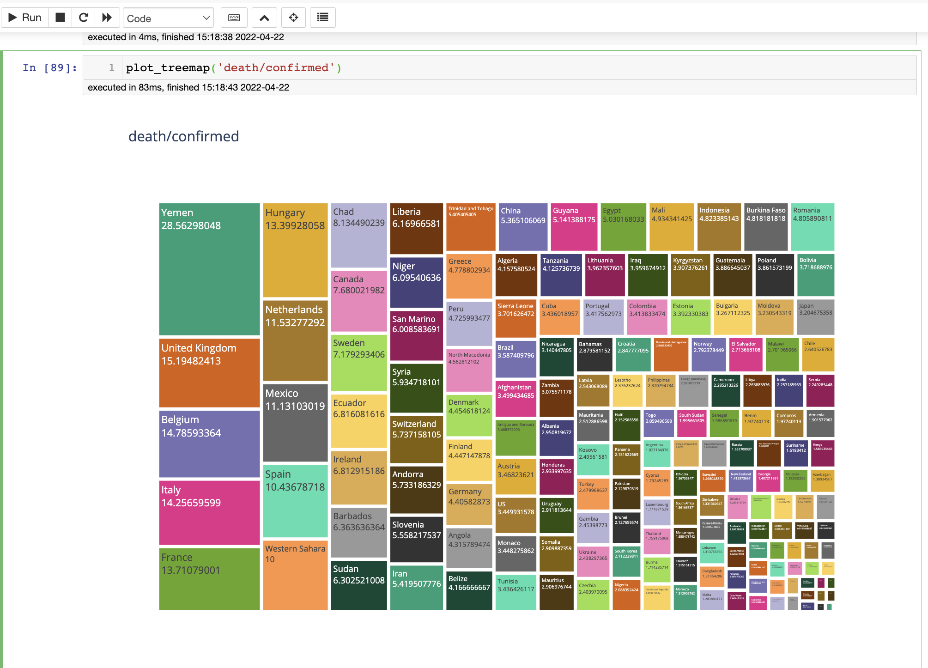
Visualization- Heat map representation for top 10 countries for the feature-
Deaths/Confirmed cases ratio

Slide 23
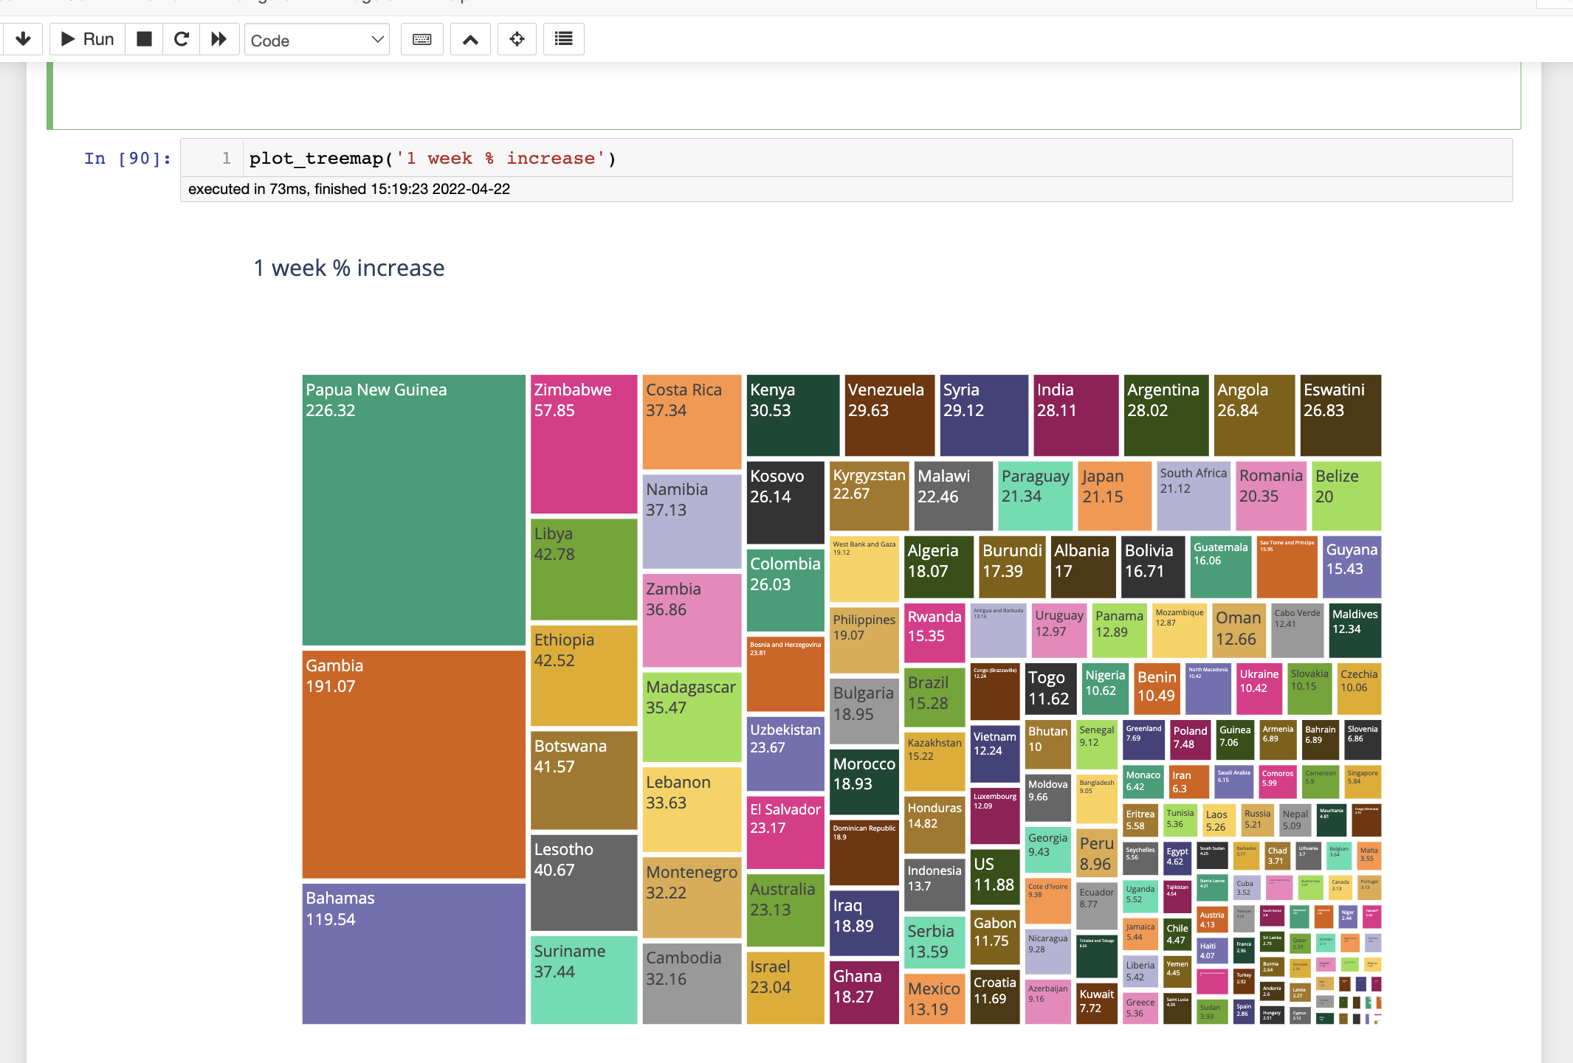
Visualization- Heat map representation for top 10 countries for the feature-
1 week % increase in the confirmed cases count.

Slide 24
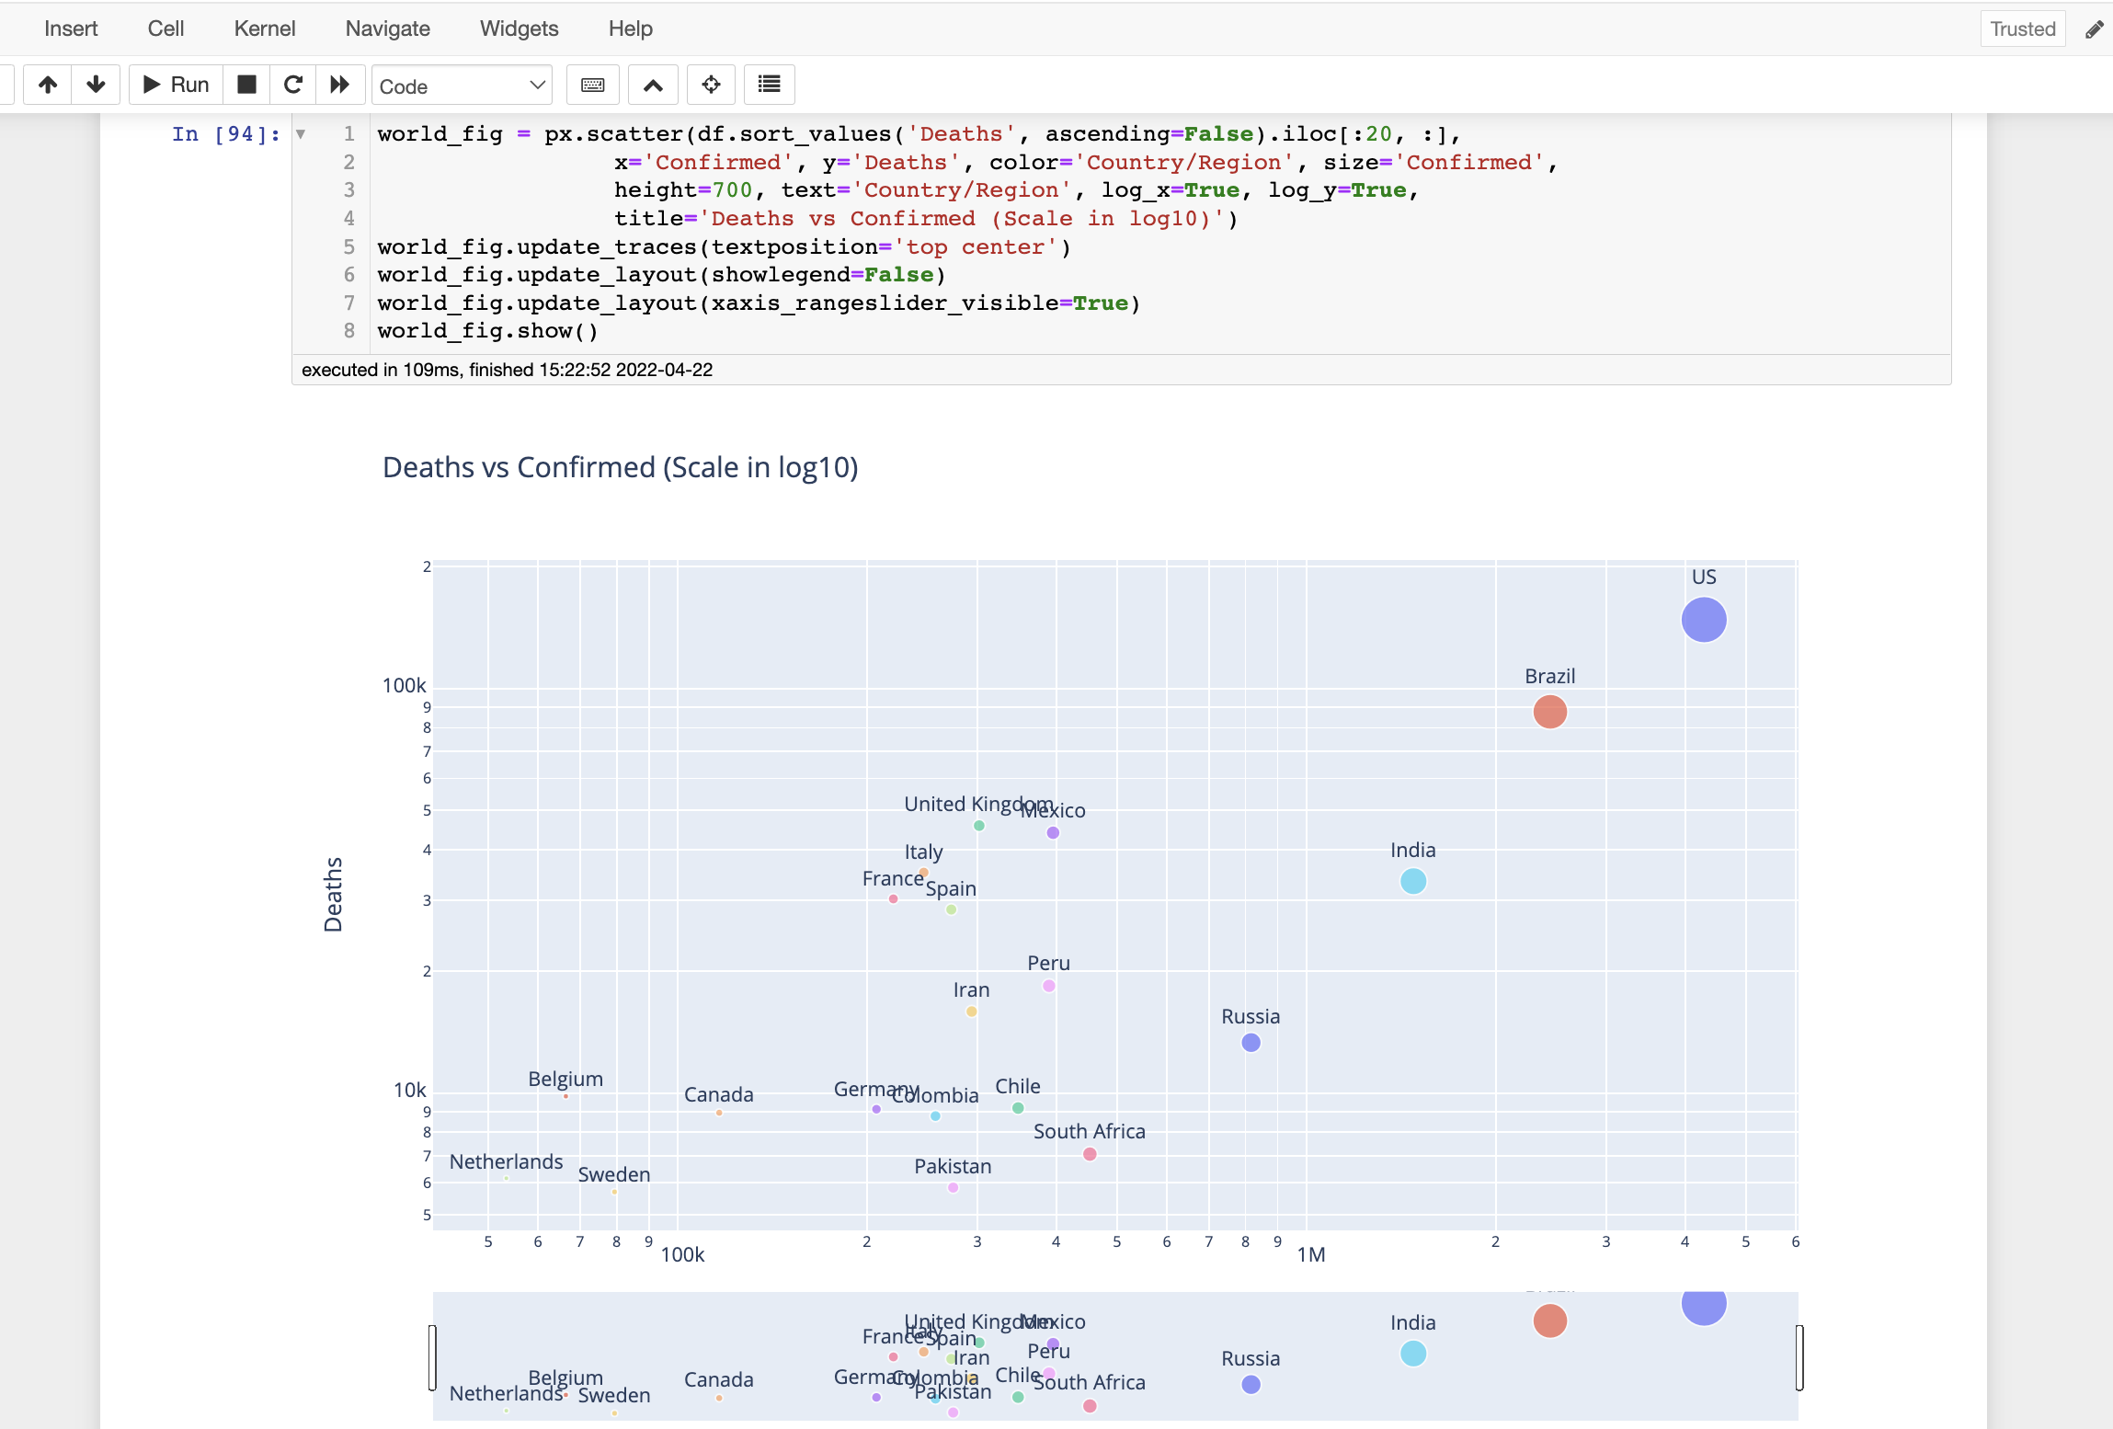
Visualization- The semi geographical representation of the countries w.r.t Deaths vs Confirmed cases. The bigger the Circle in the plot, the bigger the ratio.

Slide 25
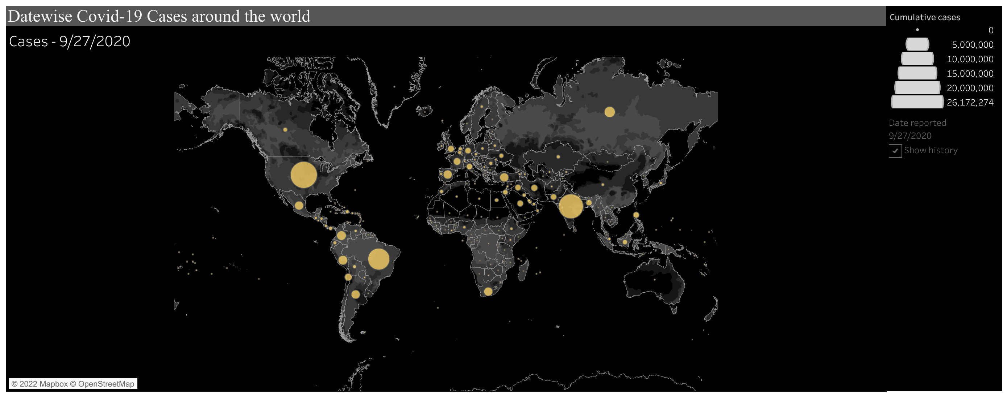

Slide 26
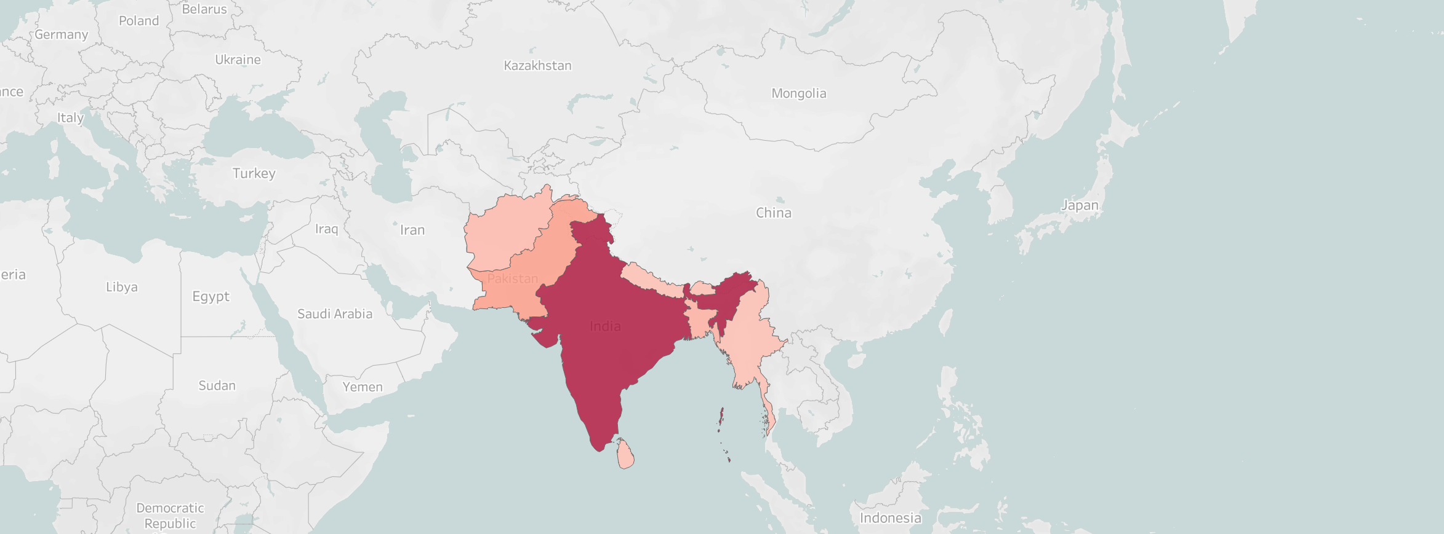
As per the tableau representation India has the highest number of cases

Slide 27
Insights
We have run 6 queries, focusing majorly on 8 features.
1.We started with a broad network, such as all countries in the world, but after analyzing the query results, we reduced it down to one Region and concentrated our efforts there.
2. Because a higher death/confirmed ratio is undesirable, this was chosen as one of the key filtering criteria.
3. Following that, the % change in the number of instances every week is calculated, and the most dispersed regions are found.
4. So far, we've restricted it to the Southeast Asia region, which has been devastated by Covid. At the moment, the attention is on the impact of the shutdown on Southeast Asian countries.
5.Later, the focus was on the number of confirmed cases before and after the lockdown.

Slide 28
We have analyzed at country level and continent level cases and though there are restrictions imposed we could see there are spike in cases. South-east Asia recorded the maximum spike where in turn India recorded the maximum increase.
Conclusion

Slide 29


